Slide 1
DARWINISM
The What and Why of

Slide 2
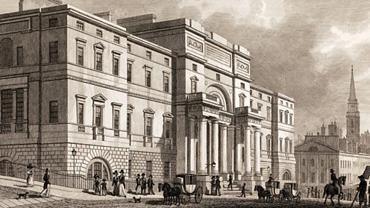
http://www.bbc.co.uk/timelines/zq8gcdm

Slide 3
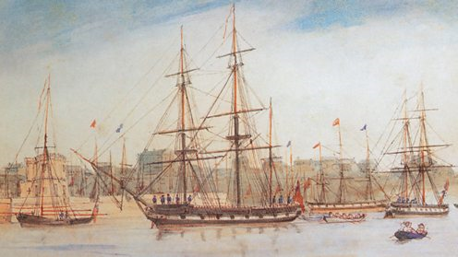
http://www.bbc.co.uk/timelines/zq8gcdm

Slide 4
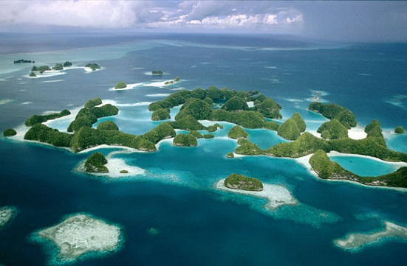
http://thegalapagosguide.net/wp-content/uploads/2014/08/galapagos-islands-ecuador-lg.jpg

Slide 5
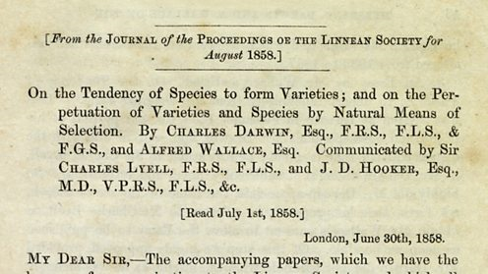
http://www.bbc.co.uk/timelines/zq8gcdm

Slide 6
Darwin’s Key Ideas
Populations change over time.

Slide 7
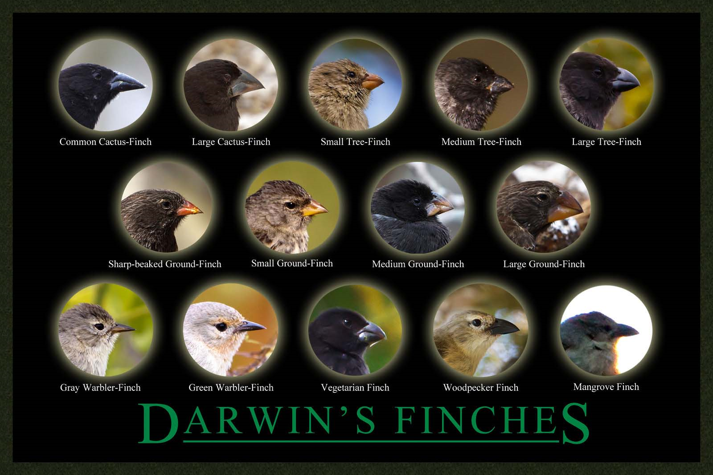

Slide 8
Darwin’s Key Ideas
Populations change over time.
Changes are due to natural selection

Slide 9
Micro and Macro Evolution
What Darwin saw… micro
What the Grants saw…
“…the best and most detailed demonstration to date of the power of Darwin’s process.” – The Beak of the Finch, 1994, Weiner, Jonathan
Micro
What the Bible suggests… micro

Slide 10
“Kind” and “Species”
A species is often defined as a group of individuals that actually or potentially interbreed in nature. In this sense, a species is the biggest gene pool possible under natural conditions.

Slide 11
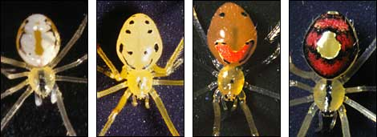
http://evolution.berkeley.edu/evolibrary/article/evo_41

Slide 12
Evolution
Biological evolution refers to the scientific theory that living things share ancestors from which they have diverged; it is sometimes called “descent with modification.
(NSTA policy statement, accessed April 2016, http://www.nsta.org/about/positions/evolution.aspx)

Slide 13
Why Darwinism matters
Rom. 1; Ps. 19 – it puts noise in God’s message.
Darwinism never stops at data.
“Although atheism might have been logically tenable before Darwin, Darwin made it possible to be an intellectually fulfilled atheist" - Dawkins

